Slide 1
Amortized Analysis
Fang Xiaolin
School of Computer Science and Engineering
Southeast University

Slide 2
Outline
Aggregate Analysis
Accounting Analysis
Potential Method

Slide 3
Amortized Analysis
Given n operations For a data structure
Some operations have high cost
Some operations have low cost
The average cost for the n operations

Slide 4
Aggregate Analysis
operation | cost
PUSH | 1
POP | 1
MULTIPOP(s,k) | min(s, k)
3 types of operations
for stack
The total Cost for running n the 3 types of operations on an empty stack?
The worst case is to run the operation multipop(s,n) n times
the total cost is O(n²)?
If pop an element, it must has been in the stack
Then the total cost is corresponding to the number of push operations
At most n push operations, thus the total cost is O(n)

Slide 5
Aggregate Analysis
cost for worst operation is k，
Total cost is O(kn)?
K-bit counter
Initial counter=0, increase 1 to counter n times
n A[7] A[6] A[5] A[4] A[3] A[2] A[1] A[0] total cost
0 0 0 0 0 0 0 0 0 0
0 0 0 0 0 0 0 1 1
0 0 0 0 0 0 1 0 3
0 0 0 0 0 0 1 1 4
0 0 0 0 0 1 0 0 7
5 0 0 0 0 0 1 0 1 8
6 0 0 0 0 0 1 1 0 10
7 0 0 0 0 0 1 1 1 11

Slide 6
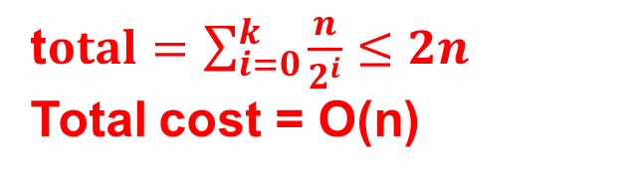
Aggregate Analysis
0 bit, change n times
1 bit, change n/2 times
2 bit, change n/2² times
t$otal=\sum_{i=0}^{k}{\frac{n}{2^{i}}}≤2n$
Total cost = O(n)
K-bit counter
Initial counter=0, increase 1 to counter n times
n A[7] A[6] A[5] A[4] A[3] A[2] A[1] A[0] total cost
0 0 0 0 0 0 0 0 0 0
0 0 0 0 0 0 0 1 1
0 0 0 0 0 0 1 0 3
0 0 0 0 0 0 1 1 4
0 0 0 0 0 1 0 0 7
5 0 0 0 0 0 1 0 1 8
6 0 0 0 0 0 1 1 0 10
7 0 0 0 0 0 1 1 1 11

Slide 7
Accounting Analysis
operation | cost
PUSH | 1
POP | 1
MULTIPOP(s,k) | min(s, k)
3 types of operations
for stack
The total Cost for running n the 3 types of operations on an empty stack?
operation | cost
PUSH | 2
POP | 0
MULTIPOP(s,k) | 0
If pop an element, it must in the stack
Pay 2$ for every push operation
Pay 0$ for other operations
Total cost = O(n)

Slide 8
Accounting Analysis
Pay 2$ for set 1
Pay 0$ for set 0
Total cost=O(2n)
K-bit counter
Initial counter=0, increase 1 to counter n times
n A[7] A[6] A[5] A[4] A[3] A[2] A[1] A[0] total cost
0 0 0 0 0 0 0 0 0 0
0 0 0 0 0 0 0 1 1
0 0 0 0 0 0 1 0 3
0 0 0 0 0 0 1 1 4
0 0 0 0 0 1 0 0 7
5 0 0 0 0 0 1 0 1 8
6 0 0 0 0 0 1 1 0 10
7 0 0 0 0 0 1 1 1 11
Notes:
每次累加都要对一位置位

Slide 9

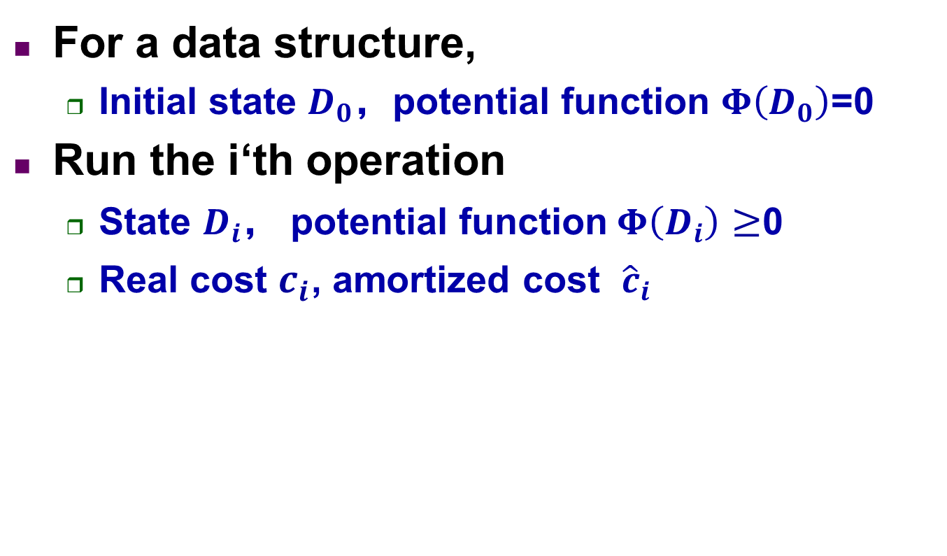

Potential Method
For a data structure,
Initial state $D_{0}$，potential function $Φ\left(D_{0}\right)$=0
Run the i‘th operation
State $D_{i}$， potential function$Φ\left(D_{i}\right)$ $≥$0
Real cost $c_{i}$, amortized cost ${\hat{c}}_{i}$
$${\hat{c}}_{i}=c_{i}+Φ\left(D_{i}\right)−Φ(D_{i−1})$$
$$\sum_{i=1}^{n}{{\hat{c}}_{i}}=\sum_{i=1}^{n}{(c_{i}+Φ\left(D_{i}\right)−Φ\left(D_{i−1}\right))}=\sum_{i=1}^{n}{c_{i}}+Φ\left(D_{n}\right)−Φ\left(D_{0}\right)$$
Total amortized cost:

Slide 10
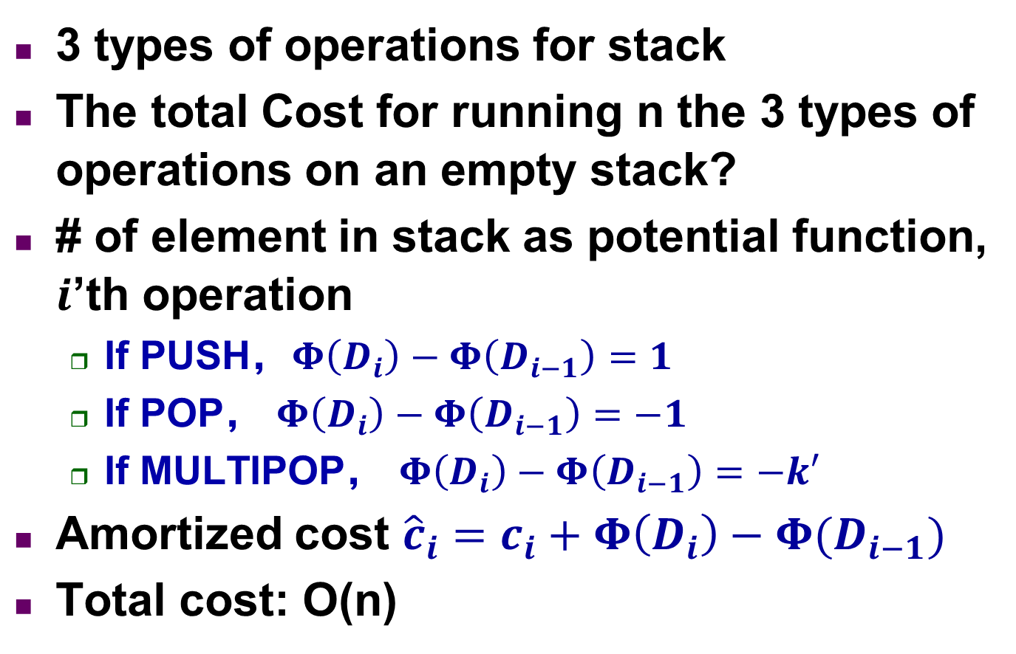
Potential Method
operation | Amortized cost
PUSH | 2
POP | 0
MULTIPOP(s,k) | 0
3 types of operations for stack
The total Cost for running n the 3 types of operations on an empty stack?
# of element in stack as potential function, $i$’th operation
If PUSH，$Φ\left(D_{i}\right)−Φ\left(D_{i−1}\right)=1$
If POP， $Φ\left(D_{i}\right)−Φ\left(D_{i−1}\right)=−1$
If MULTIPOP， $Φ\left(D_{i}\right)−Φ\left(D_{i−1}\right)=−k′$
Amortized cost ${\hat{c}}_{i}=c_{i}+Φ\left(D_{i}\right)−Φ(D_{i−1})$
Total cost: O(n)

Slide 11
Potential Method
K-bit counter
Initial counter=0, increase 1 to counter n times
n A[7] A[6] A[5] A[4] A[3] A[2] A[1] A[0] potential
0 0 0 0 0 0 0 0 0 0
0 0 0 0 0 0 0 1 1
0 0 0 0 0 0 1 0 0
0 0 0 0 0 0 1 1 2
0 0 0 0 0 1 0 0 0
5 0 0 0 0 0 1 0 1 1
6 0 0 0 0 0 1 1 0 0
7 0 0 0 0 0 1 1 1 3

Slide 12
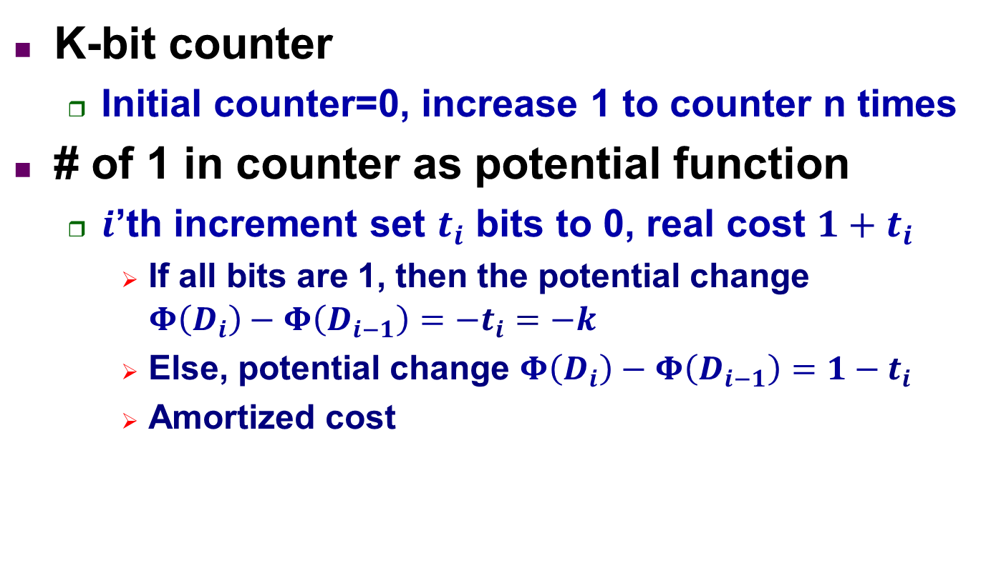
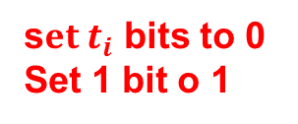
Potential Method
s$et t_{i}$ bits to 0
Set 1 bit o 1
K-bit counter
Initial counter=0, increase 1 to counter n times
# of 1 in counter as potential function
$i$’th increment set $t_{i}$ bits to 0, real cost $1+t_{i}$
If all bits are 1, then the potential change $Φ\left(D_{i}\right)−Φ\left(D_{i−1}\right)=−t_{i}=−k$
Else, potential change $Φ\left(D_{i}\right)−Φ\left(D_{i−1}\right)=1−t_{i}$
Amortized cost
$${\hat{c}}_{i}=c_{i}+Φ\left(D_{i}\right)−Φ\left(D_{i−1}\right)≤\left(1+t_{i}\right)+\left(1−t_{i}\right)=2$$

